Slide 1
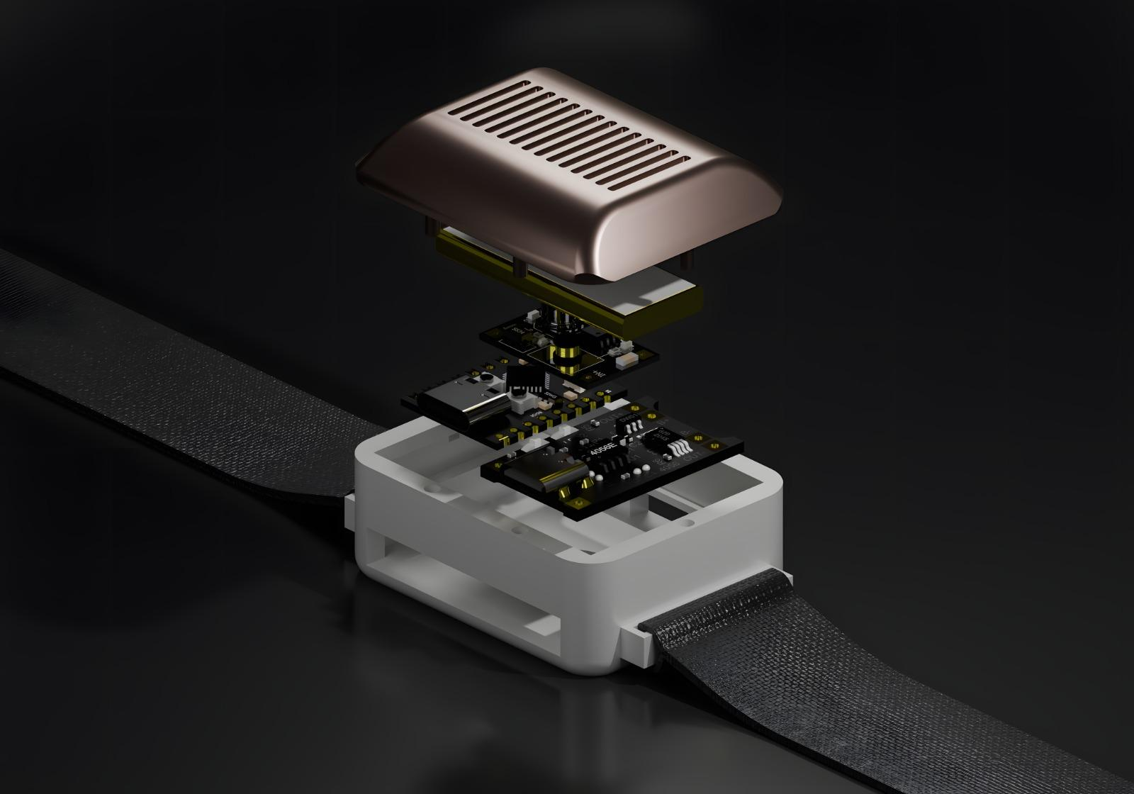
Screen-Free Navigation for 2-Wheeler Riders
A wearable haptic band converting smartphone directions into tactile feedback — keeping eyes on the road and hands on the handlebars.
TEAM 50
SUPERVISOR: DR. NARENDRAN G
Barath Dharsan, CS23I1005
Prasanna Kumar, CS23B1011
Jeevan Dhananjayan, EC23B1016
Mohamed Asif, ME23B2012
Vignesh M N S, ME23B2011

Slide 2
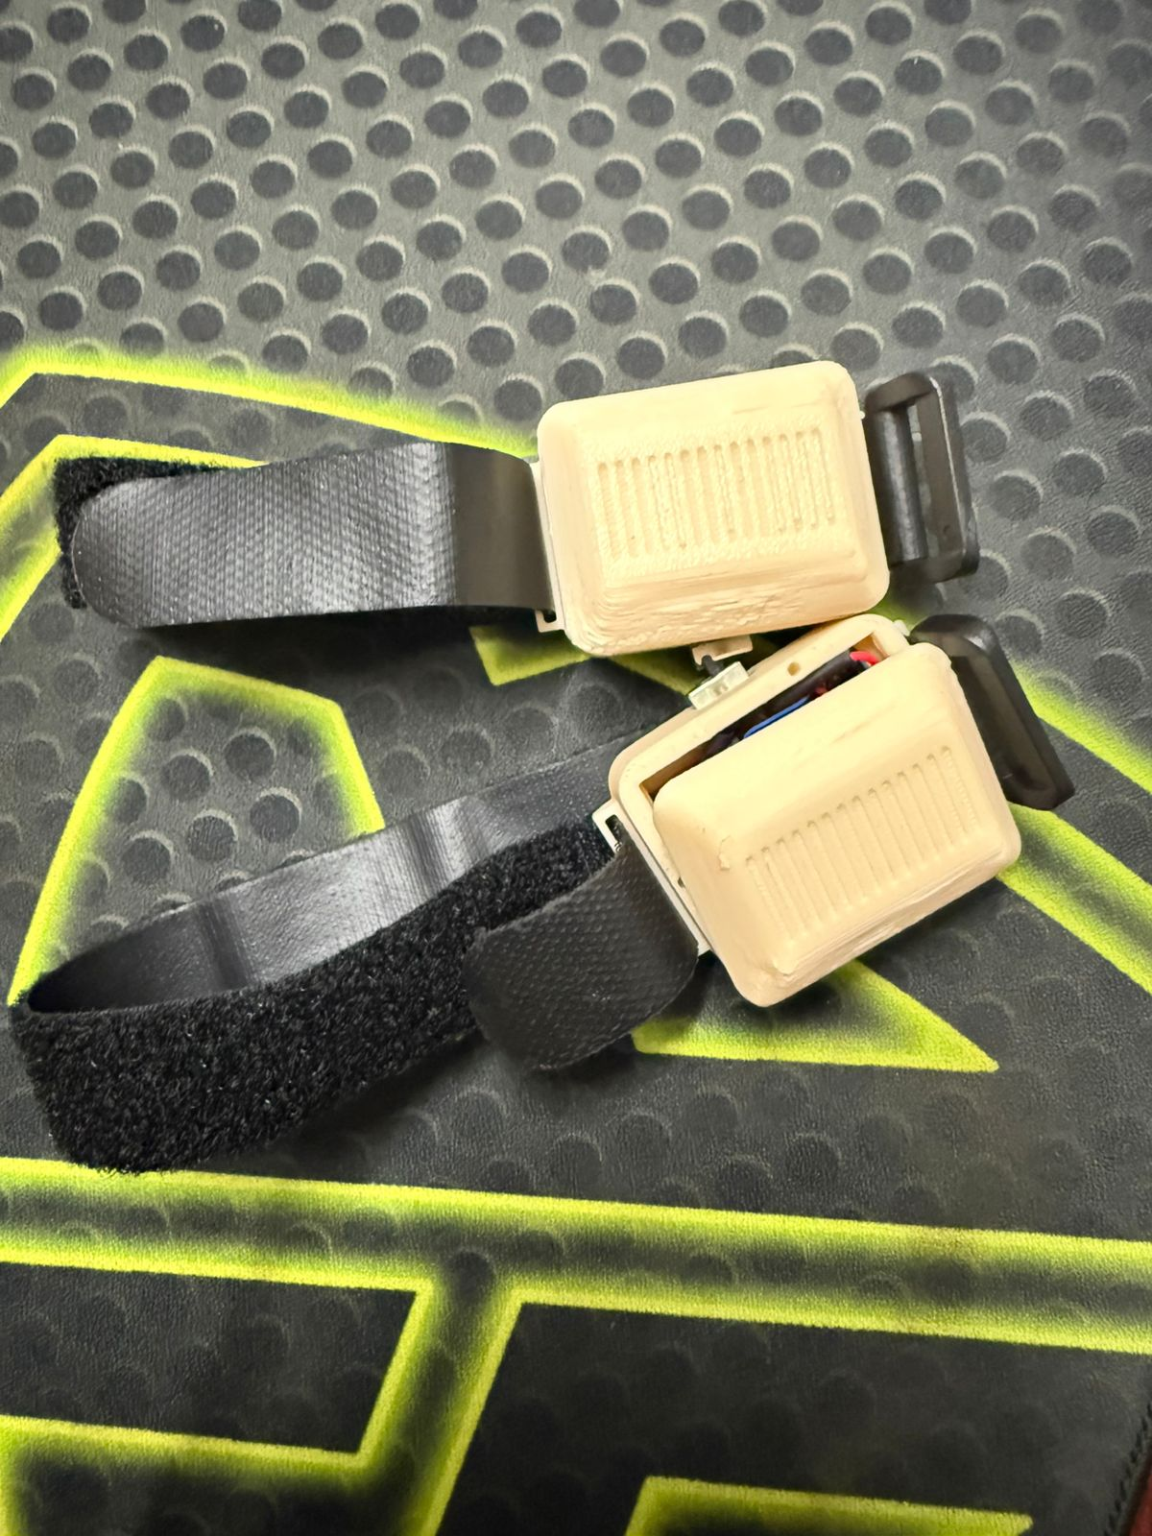
The Problem: Navigation That Costs Focus
Rider Distraction
Glancing at a phone while riding diverts critical attention from the road — a leading cause of urban two-wheeler accidents.
Gig Economy Pressure
Delivery workers on platforms like Swiggy and Rapido navigate unfamiliar routes under tight deadlines, amplifying cognitive load.
Information Overload
Static alert distances fail at high speeds, causing missed turns or last-second panic maneuvers.

Slide 3






Core Concept: Screen-Free Haptic Navigation
A proof-of-concept wearable that intercepts smartphone navigation notifications and streams dynamic vibration patterns via Bluetooth — adapting in real time to city and highway speeds.
Dual-Mode Thresholds
Tactile Signals
Hands-on-Bars
Alert distances switch automatically based on real-time GPS speed.
High-frequency vibrations on the left or right wrist indicate turn direction.
The rider's eyes stay on the road — phone stays locked in the pocket.

Slide 4

System Architecture
Flutter Front-End
Intercepts notifications locally; no paid APIs
Navigation Service
Computes distance, manages 8-second gap guard
ESP32 Wearable
Processes Bluetooth commands and triggers LR-Vibro motors
The system operates as a closed local loop — no cloud dependencies, no API costs, and zero latency between notification interception and wrist feedback.

Slide 5

The Dual-Mode Threshold System
Alert distances dynamically scale with speed to ensure timely, unambiguous guidance in both urban and highway conditions.
Maneuver
City Mode (< 60 km/h)
Highway Mode (≥ 60 km/h)
Turn 1 — Prep Alert
500 m
700 m
Turn 2 — Action Alert
250 m
450 m
Turn 3 — Immediate
100 m
250 m
Flyover Alerts
1000 m / 600 m
1200 m / 800 m
Speed mode switches automatically via GPS — no manual input required from the rider.

Slide 6
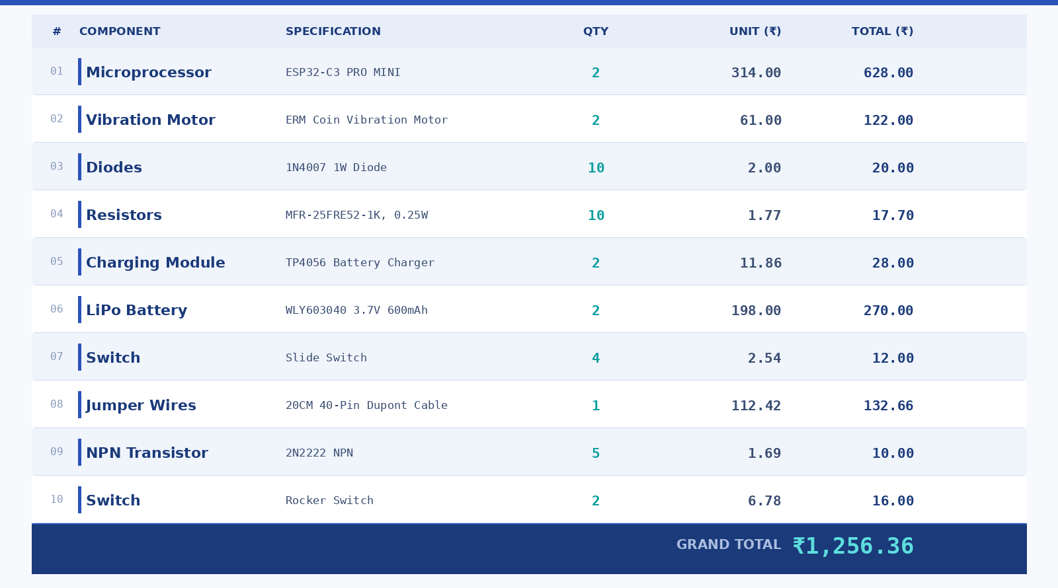
Hardware & Bill of Materials
TOTAL PROTOTYPE COST: ~₹1,256
Controller
ESP32-C3 PRO Mini — low-power Bluetooth SoC
Actuators
8 × ERM Coin Vibration Motors (3.4 mm)
Power
3.7 V 300 mAh Li-Po Battery + TP4056 Charger
Switching
2N2222 NPN Transistors + 1N4007 Diodes

Slide 7
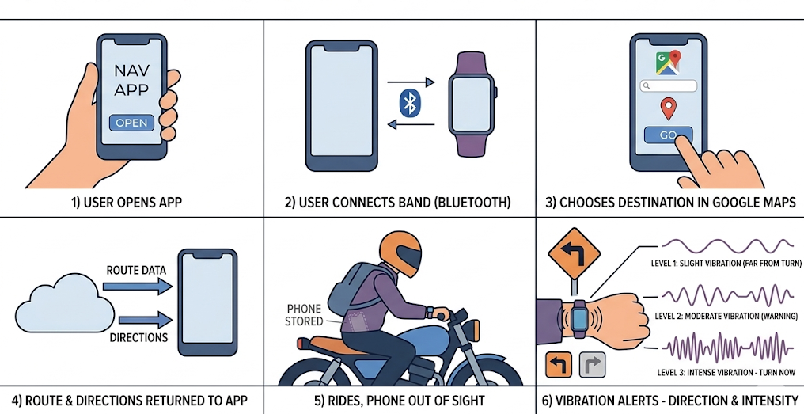
User Experience Flow

Slide 8
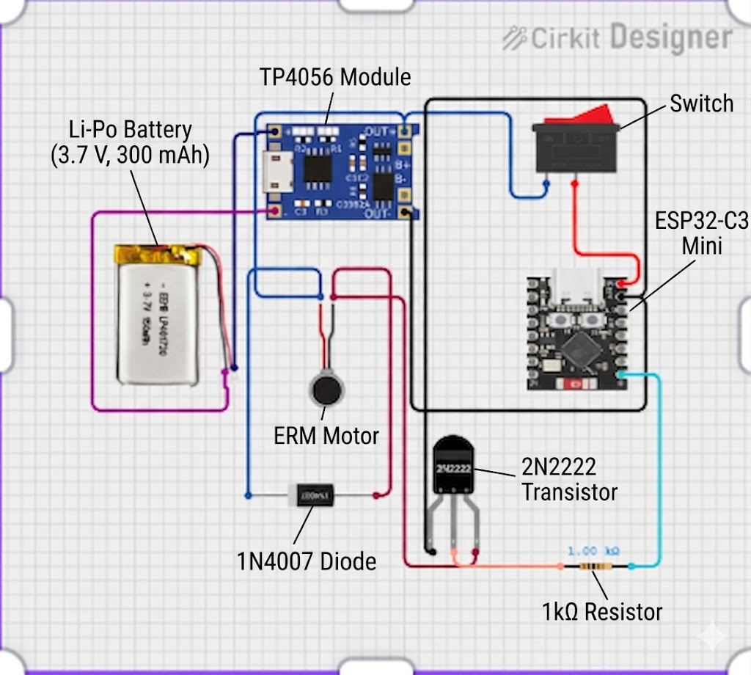
Hardware Design
Circuit schematic and 3D enclosure design of the wristband haptic module
Fig. 1 — Circuit Schematic
Fig. 2 — 3D Enclosure Design
Exploded 3D view: ventilated top cover, dual ERM motor PCB stack, and 3D-printed enclosure with velcro strap mount
ESP32-C3 Mini + ERM motor via 2N2222 transistor, 3.7V Li-Po battery with TP4056 charging

Slide 9
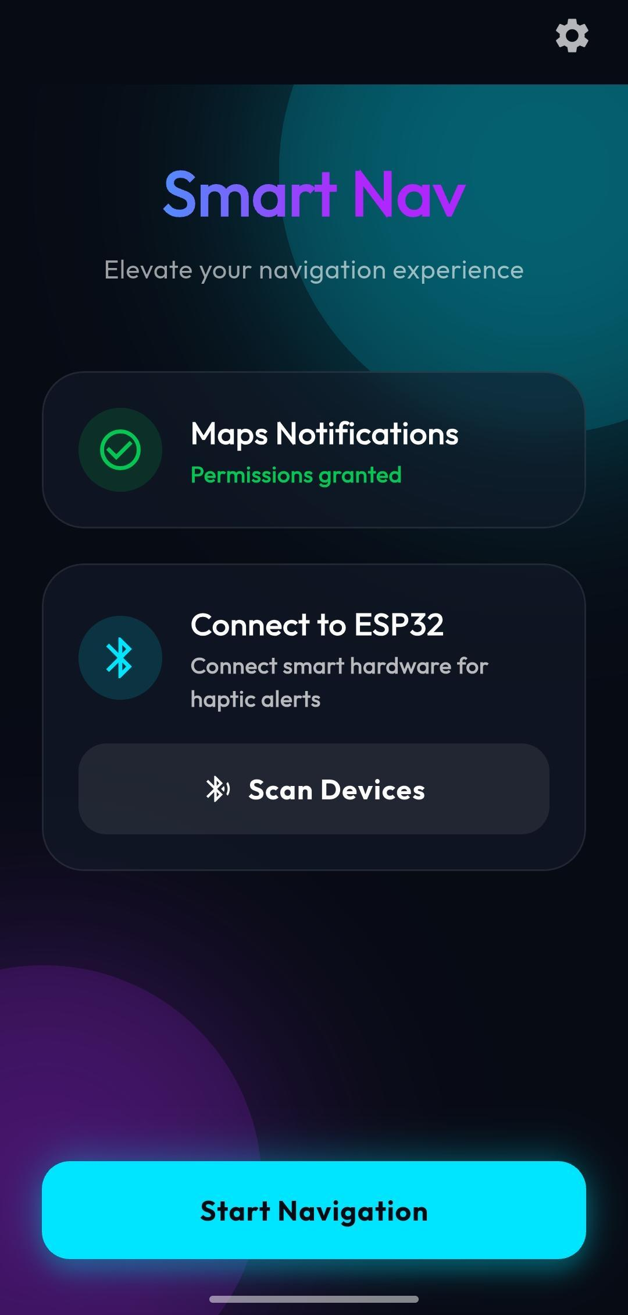
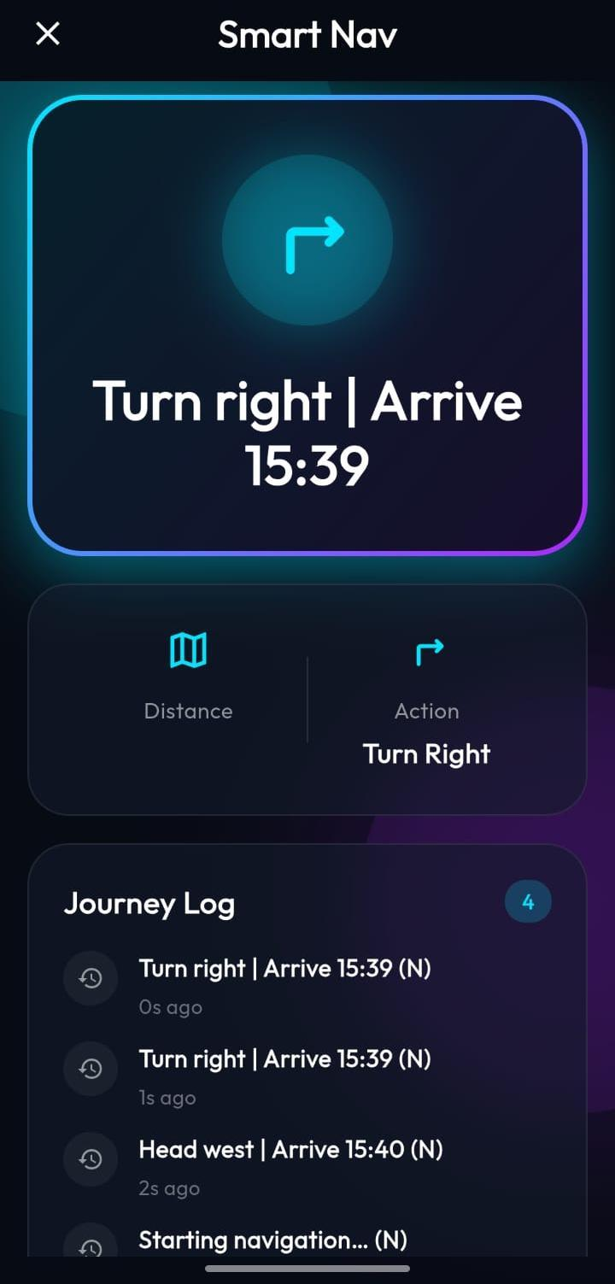
Smart Nav App Interface
Flutter-based companion app screens — Bluetooth pairing and live navigation interface
Fig. 3 — Home Page
Fig. 4 — Navigation View
Bluetooth scan, permissions check, and navigation start
Live turn direction, distance, and journey log during active navigation

Slide 10
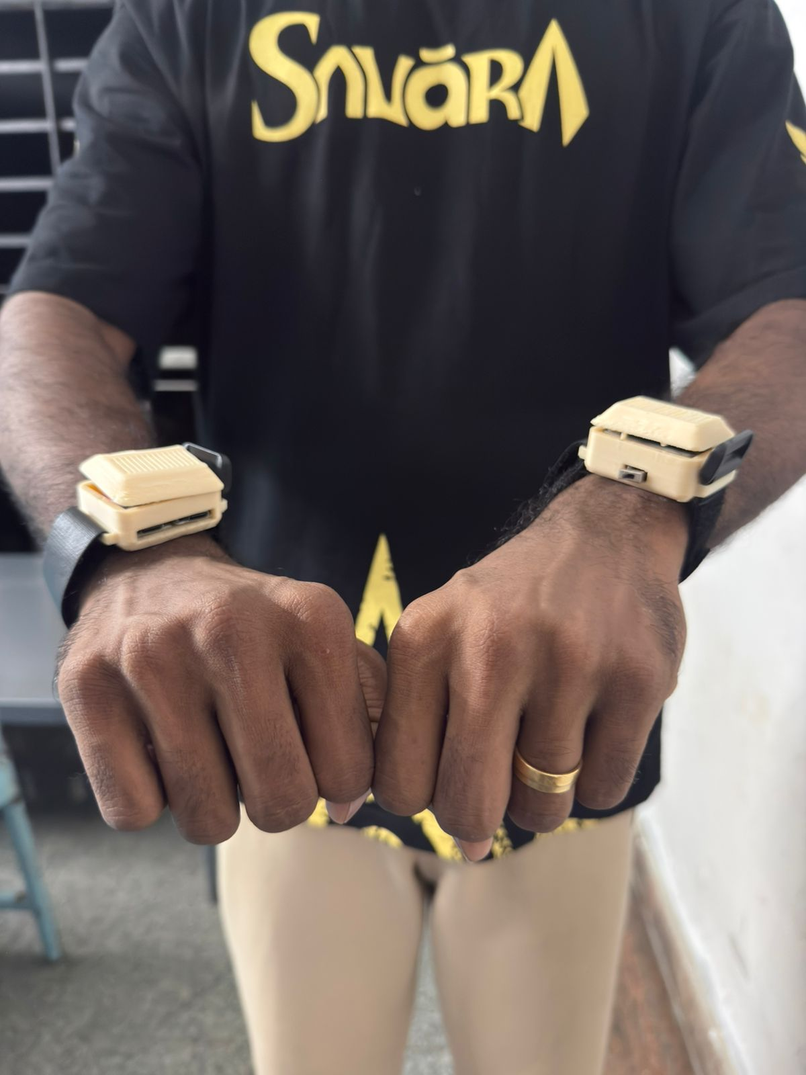
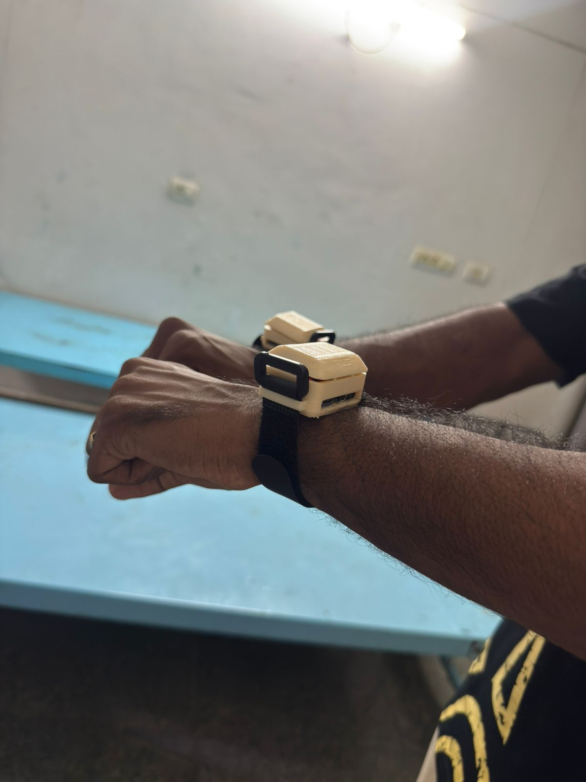
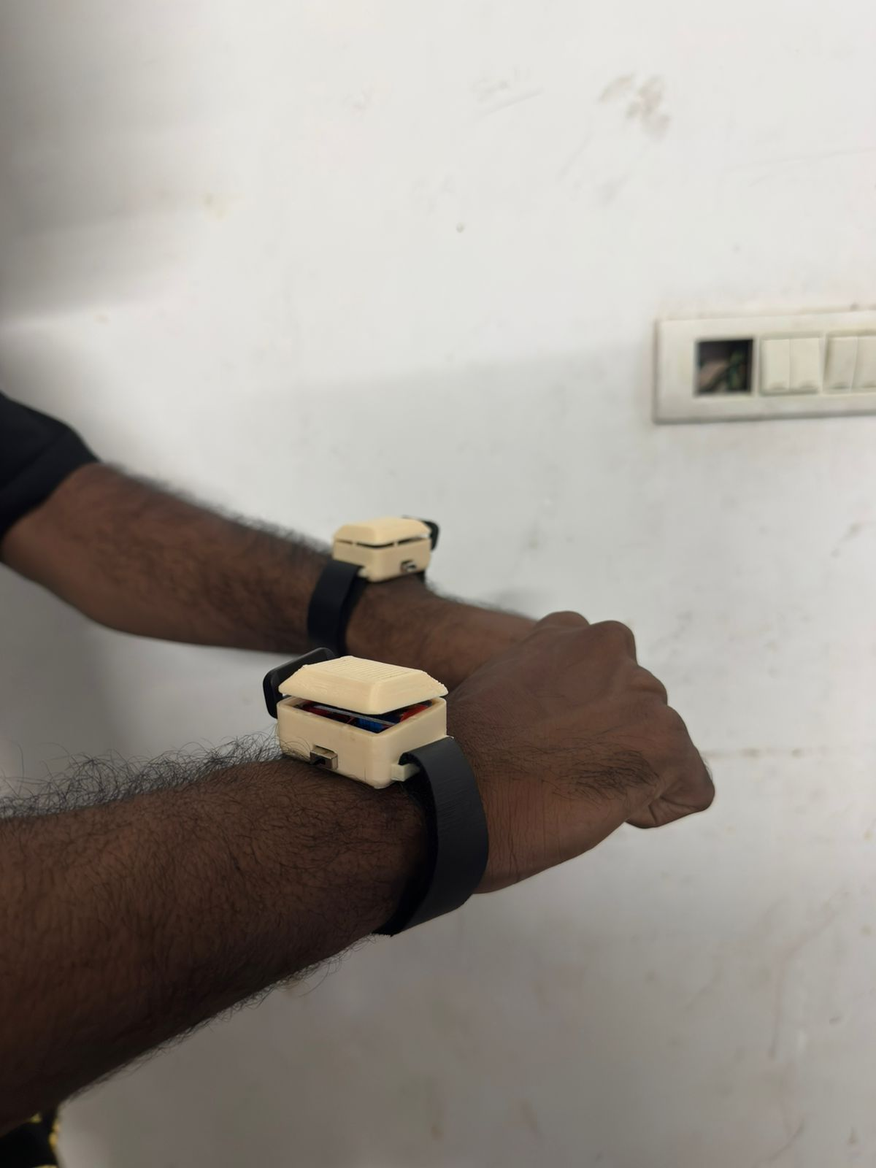
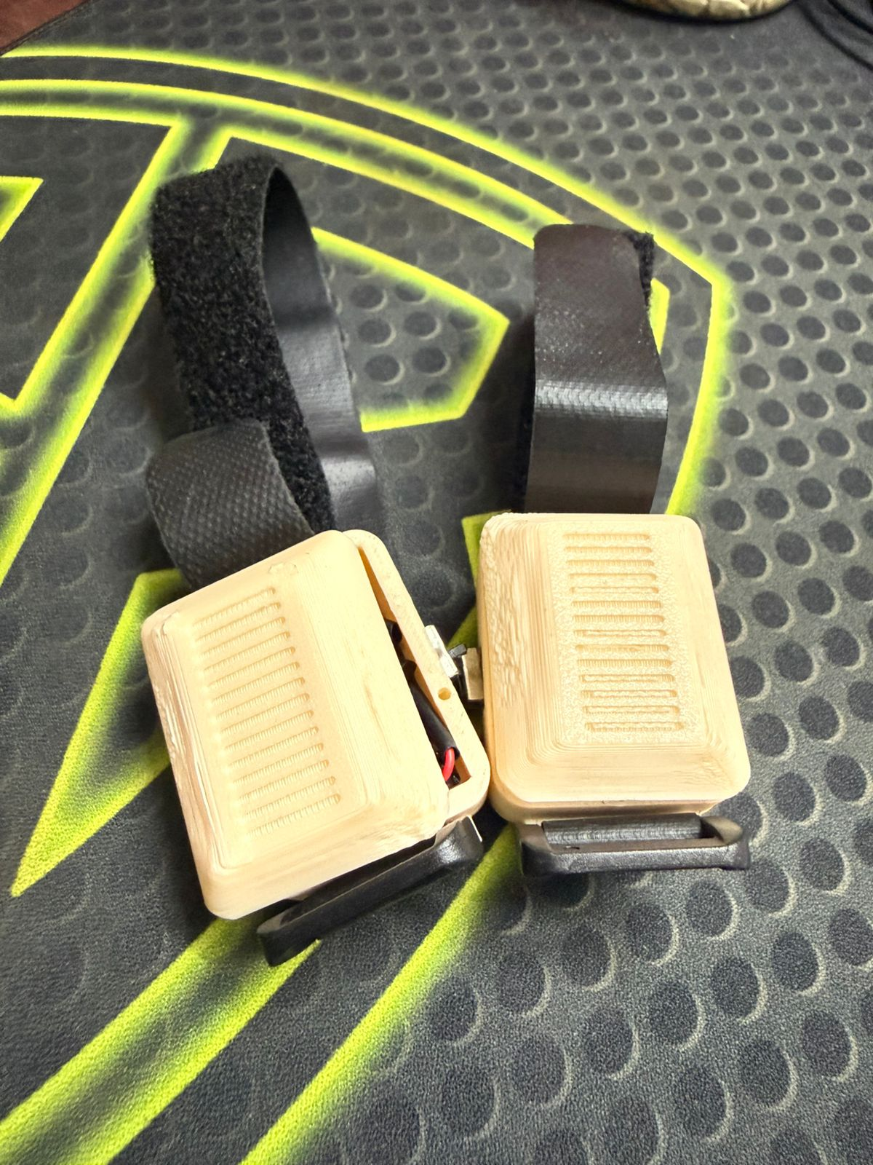
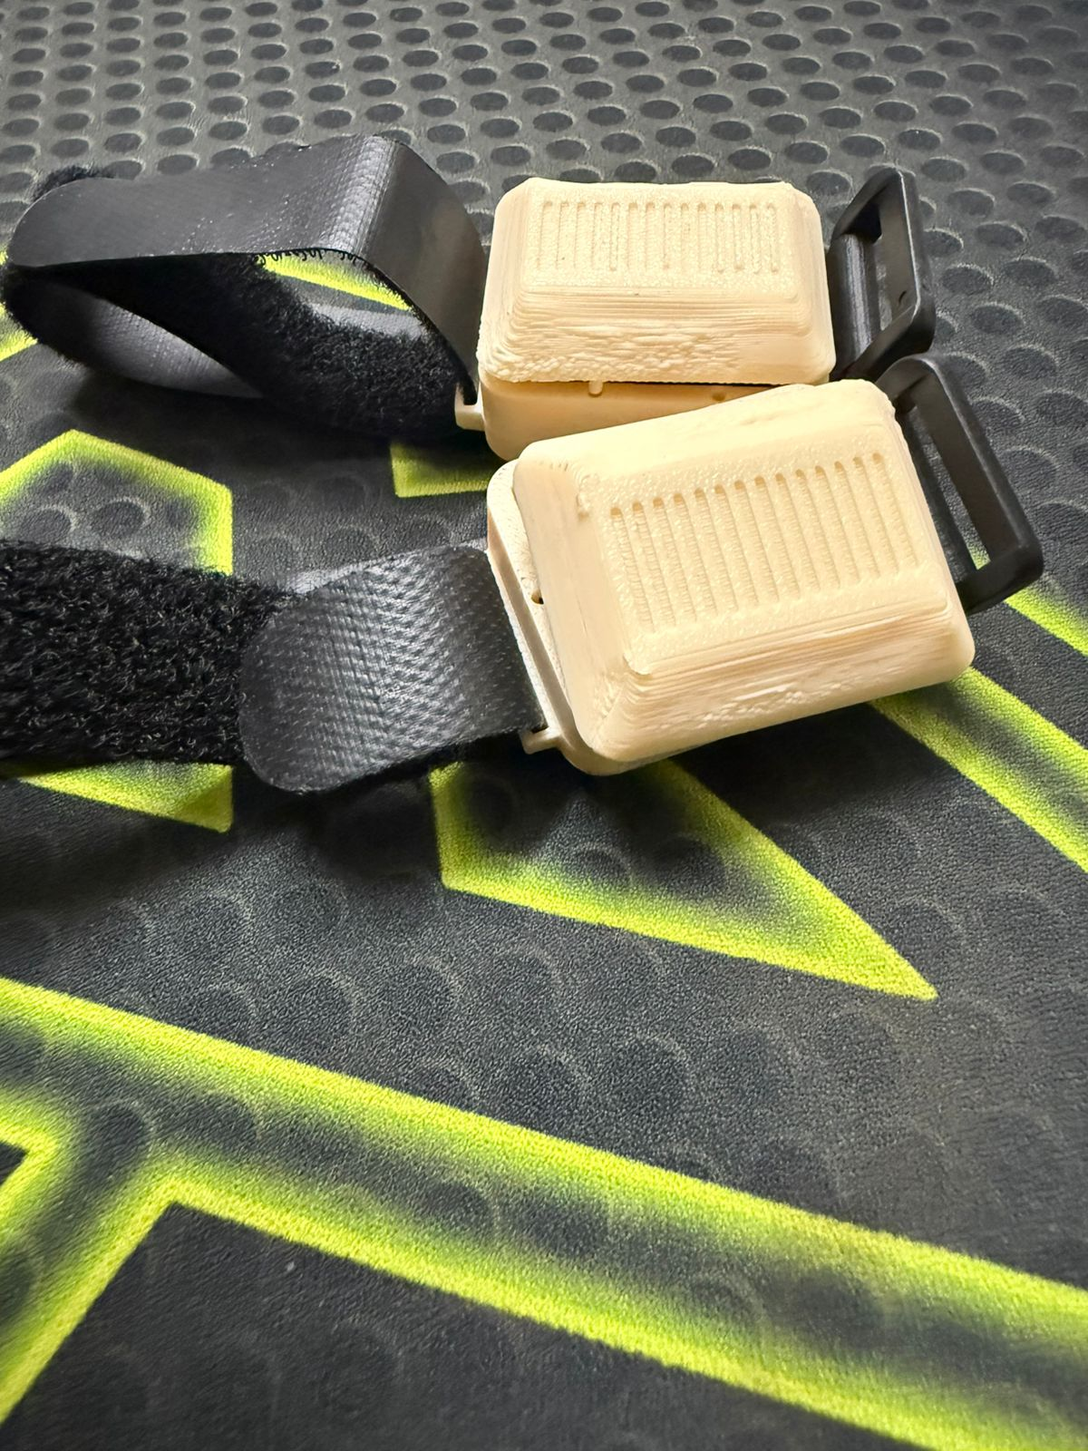
Physical Prototype Gallery
3D-printed wristband modules — worn and assembled breadboard proof-of-concept
Casing: 3D-printed PLA with velcro wrist strap
ESP32-C3 Mini + ERM motor + Li-Po battery inside each unit
Left and right wrists fitted independently for directional vibration cues
Bluetooth range tested up to 10 m with stable connectivity
Dual bands on both wrists
Single band, wrist-worn view
Open casing with PCB visible
Two units — top casing detail
Angled view — strap assembly
Interior wiring and component layout

Slide 11

Outcomes & Future Roadmap
Current Status
What's Next
1
Miniaturization
Hardware-software link successfully validated.
The ESP32 wearable reliably receives Bluetooth commands and triggers correct vibration patterns based on live navigation data.
Migrate to a custom PCB for compact, robust packaging.
2
Ergonomics
Design a sleek, sweat-proof wristband form factor for all-weather use.
3
Field Testing
Core proof-of-concept milestone achieved.
Long-term trials with gig delivery partners.

Slide 12
References & Acknowledgements
Academic References
Acknowledgements
Kiss et al. (2018)
Asif et al. (2010)
Special thanks to Dr. Narendran G for his invaluable project guidance, technical insights, and continuous support throughout this research.
Navigation Systems for Motorcyclists — foundational research on rider-centric navigation interfaces.
Haptic Feedback-Based Navigation — early work establishing tactile cue paradigms for wayfinding.

